Slide 1
NUMBER SYSTEM
By:
Prof. Rahul Patil

Slide 2
Real Number
Numbers which can be quantified and represented by a unique point on the number line are called real numbers
Examples: -1, 2 ,5/6 , 2.35 , 0 etc.

Slide 3
Rational Numbers
Numbers of the form p/q, where p and q are integers and q≠0 are called rational numbers
Examples: 5/3, 2/5, 8/9 etc

Slide 4
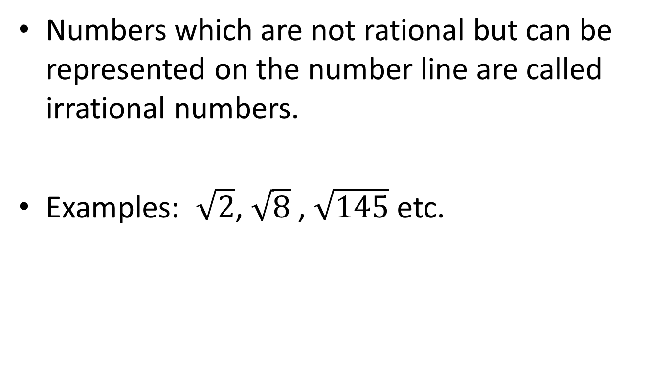
Irrational Numbers
Numbers which are not rational but can be represented on the number line are called irrational numbers.
Examples: $\sqrt{2}$, $\sqrt{8}$ , $\sqrt{145}$ etc.

Slide 5
Integers
Rational numbers of the form p/q, where p and q are integers and q= ±1 are called integers
Examples: ...,-3,-2,-1,0,1,2,3... are integers
Positive Integers - n > 0; [1,2,3...]
Negative Integers - n < 0; [-1,-2,-3...]

Slide 6
Natural Numbers
Natural numbers are the set of positive integers, that is, integers from 1 to ∞, excluding fractional n decimal part.
They are whole numbers including zero
Examples: [1,2,3...]

Slide 7
Prime Numbers
Any number other than 1 which does not have any factor apart from one and the number itself is called a prime number
Examples: 2,3,5,7,11 and 13

Slide 8
Divisibility Rules

Slide 9
Divisible by 2
A number is divisible by 2, if its unit’s digit is any of 0, 2, 4, 6, 8
Examples : 64578 and 64577 is divisible by 2 or not?

Slide 10
Divisible by 3
A number is divisible by 3, if the sum of its digits is divisible by 3
Examples : 64578 , 64576 is divisible by 3 or not?

Slide 11
Divisible by 4
A number is divisible by 4, if the number formed by the last two digits is divisible by 4
Examples : 64578 and 64580 is divisible by 4 or not?

Slide 12
Divisible by 5
A number is divisible by 5, if its unit’s digit is either 0 or 5
Examples : 64578 and 64580 is divisible by 5 or not?

Slide 13
Divisible by 6
A number is divisible by 6, if it is divisible by both 2 and 3
Examples : 64578 and 64576 is divisible by 6 or not?

Slide 14
Divisible by 7
To find out if a number is divisible by seven, take the last digit, double it, and subtract it from the rest of the number. If you get an answer divisible by 7 (including zero), then the original number is divisible by seven.
Examples : 243 and 343 is divisible by 7 or not?

Slide 15
Divisible by 8
A number is divisible by 8 if number formed using its last three digits is completely divisible by 8
Examples : 64578 and 64576 is divisible by 8 or not?

Slide 16
Divisible by 9
A number is divisible by 9 if sum of its digits is completely divisible by 9
Examples : 64579 and 64575 is divisible by 9 or not?

Slide 17
Divisible by 10
A number is divisible by 10 if its unit digit is 0
Examples : 64575 and 64580 is divisible by 10 or not?

Slide 18
Divisible by 11
A number is divisible by 11 if difference between sum of digits at odd places and sum of digits at even places is either 0 or is divisible by 11
Examples : 64575 and 64075 is divisible by 11 or not?

Slide 19
Important Formulas
• (a + b)(a - b) = (a^2 – b^2)
• (a + b)^2 = (a^2 + b^2 + 2ab)
• (a - b)^2 = (a^2 + b^2 - 2ab)

Slide 20
Law of Indices
a^m x a^n = a^(m + n)
a^m ÷ a^n = a^(m – n)
(a^m)^n = a^(mn)
(ab)^n =(a^n) (b^n)
a^0 = 1

Slide 21
Questions
The smallest 3 digit prime number is:
a.155 b.153 c.151 d.159

Slide 22
Questions
If x is a positive integer, 65/x is an integer. How many values of x?
a. 2 b.3 c.4 d.cant say
E. infinity
If x is a number & 0<x<20, 20/x is an integer. How many values of x?

Slide 23
Questions
If x is an integer, 65/x is an integer. How many values of x?
a. 2 b.3 c.4 d.cant say
If x is a number & 0<x<20, 20/x is an integer. How many values of x?
a. 4 b.5 c.10 d.Infinity e.Can’t say f. 6

Slide 24
If one third of one fourth of a number is 15, then three-tenth of that number is
a.35 b.36
c.45 d. 54

Slide 25
The denominator of a fraction is 2 more than numerator. If the numerator as well as denominator is increased by 4, the fraction becomes 8/10. Find the original fraction.
a. 2/3 b. 1/3 c. 4 /7 d. 2/5

Slide 26
What fraction of an hour is a second?
a.1/24 b.1/60 c.1/120 d.1/3600

Slide 27
How many natural numbers between 28 and 65 are divisible by 7?
a.5 b.6
c.7 d.4

Slide 28
6/7 of a certain number is 96. Find quarter of that number.
a.112 b.32
c.56 d.28

Slide 29
If the numbers of boys in a class are 8 times the number of girls, which value can never be the total number of students?
a. 27 b.45
c.81 d.42

Slide 30
5 times a positive number is less than its square by 24. What is the integer?
a. 5 b. 8
c. 7.5 d. 9

Slide 31
A man has some hens and cows. If the number of heads be 48 and the number of feet equals 140, then the number of hens will be:
(TCS 2018)
22 b. 23
c. 24 d.26

Slide 32
Find the unit digit of 5^23?
2 b. 5
c. 4 d.6

Slide 33
Find the unit digit of 3^16?
7 b. 9
c. 1 d.3

Slide 34
Find the unit digit of 2^18?
2 b. 4
c. 6 d.8

Slide 35
Find the least number which is exactly divisible by 12, 15, and 20.
a. 40 b. 50
c. 60 d. 80

Slide 36
If 2x+3y=34 and x+y=13 find x?
a.8 b.5 c.18 d.12

Slide 37
Two parking lots can hold a total of 115 cars. The green lot can hold 35 fewer cars than the Red lot. How many cars can the Red lot hold?
a. 35 b.40 c.70 d.75

Slide 38
The product of fraction A and B is (8/49). Find the value of fraction A, if fraction A is twice fraction B.
a. 7/9 b. 5/7 c. 4/7 d. 5/9

Slide 39
A number when divided by 9 leaves a remainder 5. When the square of the number is divided by 9, the remainder is:
a.4 b.5 c.6 d.7

Slide 40
If a is even and b is odd numbers, then which of the following is even?
a. a/b b. ab c. a+b d. a-b

Slide 41
If the sum of two prime numbers x and y is odd, then the product of x and y must be divisible by
a.2 b.3 c.4 d.5

Slide 42
The sum of squares of three numbers is 138 and the sum of their products taken two at a time is 131. Find their sum.
a. 35 b. 42 c. 20 d.18

Slide 43
The price of 10 chairs is equal to that of 4 tables. The price of 15 chairs and 2 tables together is Rs. 4000. The total price of 12 chairs and 3 tables is: (Mphasis 2019)
a.Rs. 3500 b.Rs. 3750 c.Rs. 3840 d.Rs. 3900

Slide 44
Consecutive Numbers:
Example: 1,2,3,4……………….
1st No = x, 2nd No = x+1, 3rd No = x+2
Consecutive Even Number / Odd Number:
1st No = x, 2nd No = x+2, 3rd No = x+4

Slide 45
Three times the first of three consecutive odd integers is 3 more than twice the third. The third integer is:
a.9 b.11 c.13 d.15

Slide 46
What is the sum of two consecutive even numbers, the difference of whose squares is 84? (TATA MOTORS 2017)
a.34 b.38 c.42 d.46

Slide 47
Find a positive number which when increased by 17 is equal to 60 times the reciprocal of the number. (L&T 2018)
a.3 b.10 c.17 d.20

Slide 48
The sum of two number is 25 and their difference is 13. Find their product.
a.104 b.114 c.315 d.325

Slide 49
Thank you !!

